Slide 1
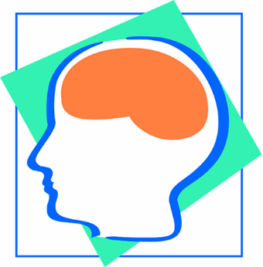
Rehabilitation is…
"a process aimed at enabling
persons with disabilities to reach and maintain their optimal... functional levels”
  World Health Organization (WHO)
Westmead Brain Injury Rehabilitation Service

Slide 2
Our brain…
Frontal lobe
Parietal lobe
The Frontal Lobes
Make plans
Learn from mistakes
Work out how to do things
Adapt to new situations
Control emotions and impulses
Control activity level
Control expressive language
Control voluntary movement
Help us 'get along' with
other people.
Occipital lobe
Temporal lobe
Brainstem
Cerebellum

Slide 3
Our brain…
Parietal lobe
Occipital lobe
The Occipital Lobes
Receive visual information
Interpret colour, shape & distance.
Temporal lobe
Brainstem
Cerebellum

Slide 4
Our brain…
Parietal lobe
The Parietal Lobes
Monitor sensation and
body position
Control reading
Recognise faces
Understand time
Judge what objects are
Temporal lobe
Cerebellum
Brainstem

Slide 5
Our brain…
Temporal lobe
The Temporal Lobes
Look after memory and new learning
Control how things are ordered
Receive auditory messages
Understand spoken language, rhythm & intonation
Cerebellum
Brainstem

Slide 6
Our brain…
The Cerebellum is sometimes called ‘the little brain’
Connects the brain stem to the cerebral lobes.
Controls balance, & coordinates voluntary movements
The Brainstem is the stemlike portion of the brain through which all the sensory & motor nerve fibres connect to the spinal cord.
Controls basic functions such as breathing, blood pressure & swallowing
Cerebellum
Brainstem

Slide 7
More information…
Acquired Brain Injury - The Facts (4th Edition, 2013) www.synapse.org.au
Fact sheets & statistics: www.bianet.au
NSW Agency for Clinical Innovation: vv www.aci.health.nsw.gov.au

